Slide 1

The Demographic Revolution and Welfare Policy
Taiwan Inclusive:
Trends, Opportunities, and Challenges
Yong Cai
Department of Sociology & Carolina Population Center
University of North Carolina, Chapel Hill

Slide 2
Outline
Taiwan’s Demographic Challenges
  Low Fertility Trap
  Rapid Aging
Changes in Economic Life Cycle
  Later Entry and Early Exit
  Increase Consumption
  Increase Public Transfer
Welfare Policy
  Fertility, Education, Retirement, Healthcare
Taiwan in a Global Context

Slide 3
Taiwan’s Fertility Crisis (TFR)
Source: Statistical Yearbook of Interior

Slide 4
Taiwan’s Fertility Crisis (Monthly Births)
Source: Statistical Yearbook of Interior

Slide 5
Taiwan’s Fertility Future (Projections)
Data source: 行政院經濟建設委員會《中華民國 2012 年至 2060 年人口推計》

Slide 6
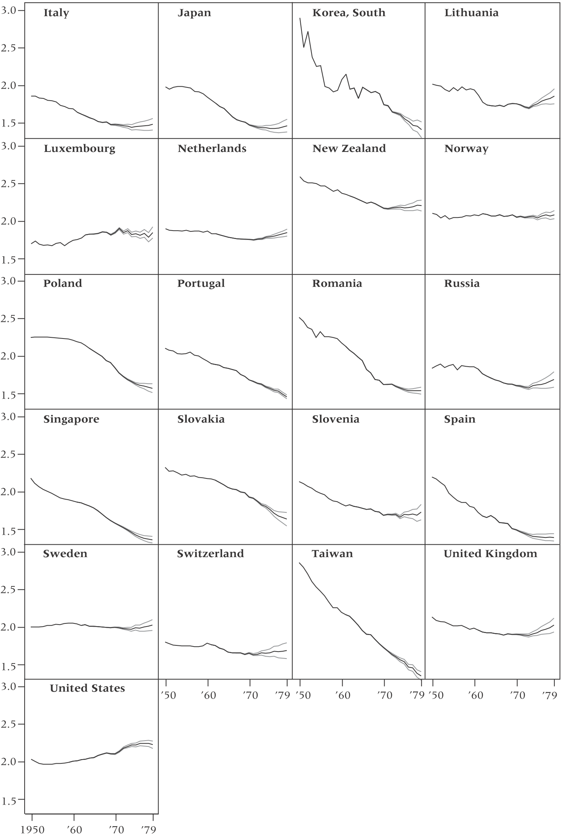
Taiwan’s Fertility Future
Source: Myrskylä et al. 2013

Slide 7
Low Fertility Trap
After fertility falls below certain level (1.5), it’s very difficult to pull it back
  Examples: Japan, Italy, Spain…
Demographic, social, economical, and political
  Calculated choice, competitive pressure and individualism
  Confucian culture and low fertility
  Internalization and ideational change
What lies ahead? What can be done?
While there are uncertainties in fertility, rapid aging is a given.

Slide 8
Rapid Aging
Data source: Statistical Yearbook of Interior, 行政院經濟建設委員會《中華民國 2012 年至 2060 年人口推計》

Slide 9
Rapid Aging (Population of 65+)
Data source: 行政院經濟建設委員會《中華民國 2012 年至 2060 年人口推計》

Slide 10
Rapid Aging (Population of 65+)
Data source: 行政院經濟建設委員會《中華民國 2012 年至 2060 年人口推計》

Slide 11
Rapid Aging (Median Age)
Data source: 行政院經濟建設委員會《中華民國 2012 年至 2060 年人口推計》

Slide 12
Changing Age Structure (2012)
Data source: 行政院經濟建設委員會《中華民國 2012 年至 2060 年人口推計》

Slide 13
Changing Age Structure (2060)
Data source: 行政院經濟建設委員會《中華民國 2012 年至 2060 年人口推計》

Slide 14
Changing Age Structure (2012 vs. 2060)
Data source: 行政院經濟建設委員會《中華民國 2012 年至 2060 年人口推計》

Slide 15
Changing Age Structure (2012-2060)
Data source: 行政院經濟建設委員會《中華民國 2012 年至 2060 年人口推計》

Slide 16
National Transfer Account
Producing and consuming: the economic lifecycle
  Age profiles
Sharing and saving are essential counterparts to the economic lifecycle.
Private and public transfers.
National Transfer Account (Equation):
www.ntaaccounts.org

Slide 17
Per Capita Labor Income and Consumption, Taiwan (2003)

Slide 18
Life Cycle Change, 1980 vs. 2000 (Indexed)
Data source: www.ntaacounts.org

Slide 19
Life Cycle Change (Prime Working Year Consumption/Income Ratio)
Data source: www.ntaacounts.org

Slide 20
Later Entry and Earlier Exit (First/Last Age Earning at a Proportion of Peak Income)
39
yrs
33
yrs
Data source: www.ntaacounts.org

Slide 21
Asset-based reallocations and public transfers have increased over time; familial transfers have declined precipitously.
NHI began in 1995; net public transfers increased.
Source: www.ntaacounts.org Andrew Mason

Slide 22
65-year-olds
67% assets, 2% public, 32% private
85-year-olds
23% assets, 39% public, 38% private
Source: www.ntaacounts.org Andrew Mason

Slide 23
Life-cycle Consumption and Income
US 2000

Slide 24
Changing Age Structure (2012-2060)
Data source: 行政院經濟建設委員會《中華民國 2012 年至 2060 年人口推計》

Slide 25
Changing Age Structure (2012-2060)
Data source: 行政院經濟建設委員會《中華民國 2012 年至 2060 年人口推計》

Slide 26
A Very Challenging Future
Combining demographic and life cycle factors together suggests a very challenging future
  Later entry, earlier exit: less savings
  Increase in overall consumption
  More spending on education
  More spending on healthcare
  More need for old age support
  Higher burden on younger generation
  More pressure on fertility?

Slide 27
Welfare Policies
Retirement benefits
Healthcare
Social safety net
Boosting fertility
Investment in education
……
More public transfer
Higher tax?

Slide 28
Population is Destiny
Population momentum
  the current trends will continue before it can be reversed
Demographic dividends
  Demography is among key factors behind economic development
  Demographic burdens
Taiwan is not alone
  Taiwan is following Japan
  S. Korea, Singapore, HK
  Mainland China
Demography
Institutions
Capital
Technology
Market

Slide 29
Pace of Aging, Selected Countries

Slide 30
A Dire Strait?
Demographic situation across the strait is not much better, and is worse in several aspects.
Taiwan certainly has, and is expected to continue having some competitive advantages.
A more flexible immigration policy might be necessary, but comes with political implications.

Slide 31
Thank you!

